Slide 1
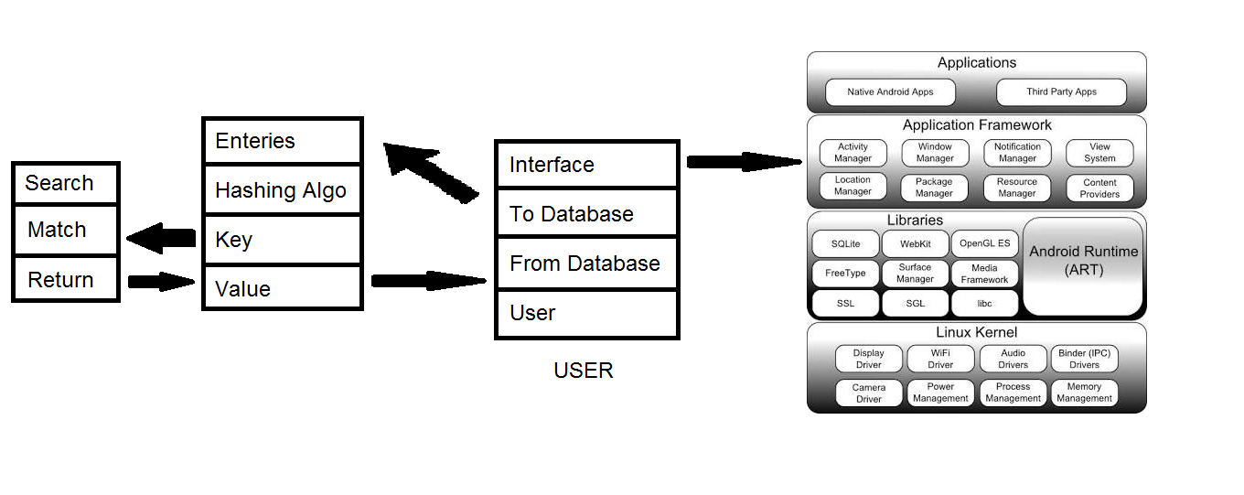
Approach Details
Ministry Category: All India Council For Technical Education
Problem Statement: One point student/faculty detail
verification through functional application
software
Team Leader Name: Dushyant Kr. Singh
Problem Code: AIC3
College Code: 161
Description
Since majority of students and faculties are having smartphones, the idea is to make it available to everybody. Creating an application for smartphone will create a common platform and as far as those without smartphones are considered, can either use someone else’s smartphone to login and then logout. What the application does is it takes only first 11 digits of an individual’s aadhar (note it is not 12) and generates the 12th digit on its own using verhoeff’s algorithm to make it more secure and remove the threat of password leakage. We will also integrate biometric too to completely assure security.

Slide 2
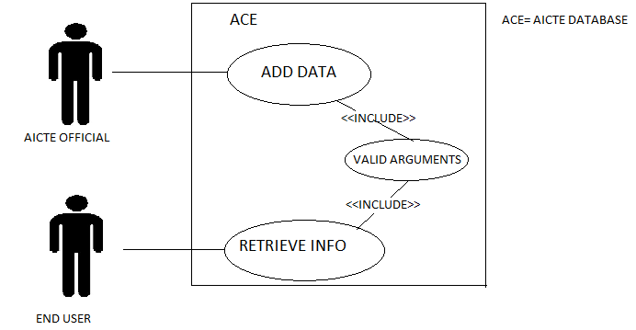
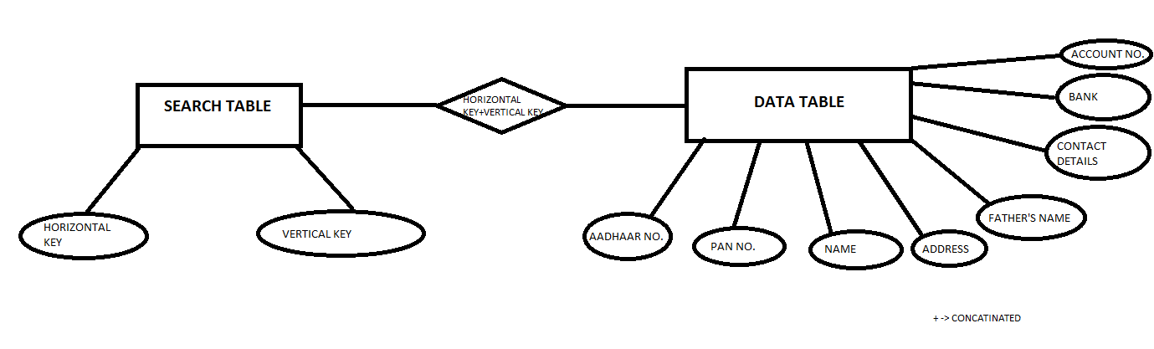
Approach detail
USE CASE
The main use case of this application will be for verification of details provided by student/faculty to confirm authentication of the person under consideration. Since the application will be linked to aadhar id and PAN, we can be assured that the information is correct and verified. This will save trouble of going through all the documents manually to save time and cut the cost.
Show stopper/Dependency
SHOW STOPPER:
Our application fully digitalizes all the documents of a person that can be used for verification a person’s identity anywhere as it is linked with aadhar and PAN. This will eliminate the need of carrying multiple documents. The user just need to enter 11 digits of UID or PAN and all the verified details will pop up. There will be an option to share the documents for submitting details. Eg. Currently, during examination a students identity and presence is verified by various paper works that are done during exam hours, which wastes time. After this app, students just need to carry there admit card and this app can be used to verify the presence and authentication of a student.
Another show stopper is security and speed of authentication of data retrieval.
DEPENDENCY:
Our dependency on government consists of no hardware dependency, but following data (shown in below diagram) in required.

